Slide 1
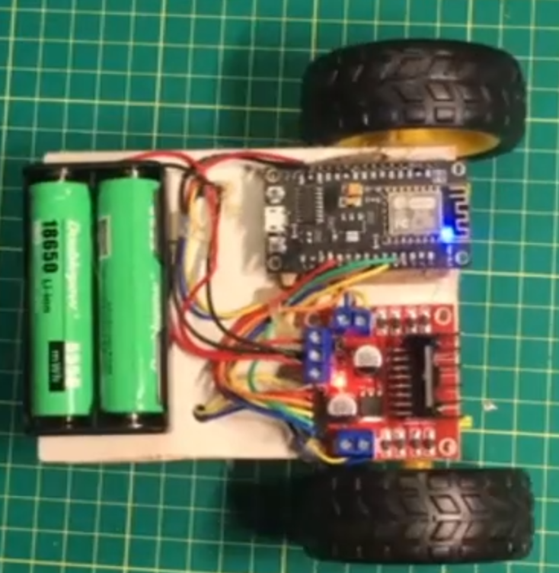
Moving a robot.
How can we make the robot move?
Obviously, we connect power to the DC motors.
This will move it in a straight line at a set speed.

Slide 2
Turning a robot.
How can we make the robot turn?
The wheel directions are fixed, so we need to vary the speed of the wheels. By making one wheel turn faster than the other we can control the direction
GO
STOP

Slide 3
There are many limits to this.
We are using an Arduino pin for each wheel.
The robot can only move forwards
The robot has a large turning circle
We cannot alter the speed of the robot.

Slide 4
Reverse
If the motor can reverse direction it gives us more manoeuvrability. Not only can we go in reverse, but we can also “spin” on the spot to turn around.
Let’s look at a short video.

Slide 5
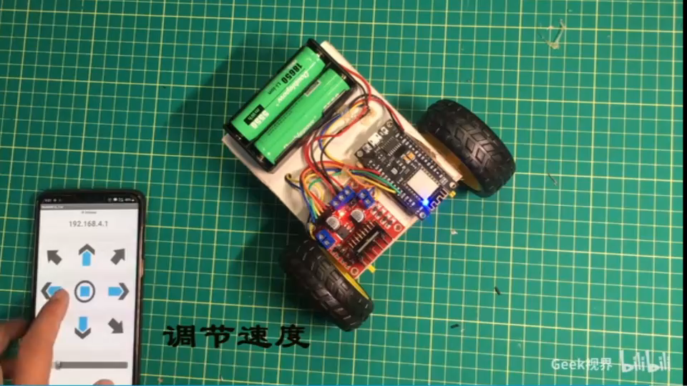

Slide 6
This is what we want to do!
The way to make a DC motor turn faster or slower is by changing the voltage.
But our Arduino boards can only output a single voltage – 5V. They can’t output 2V or 3.5V.
So, how can we change the speed of our motor?

Slide 7
PWM
On your Arduino, you have seen the pins called PWM. You know that they control how fast a motor will turn. But do you know how they do it?
Our Arduinos can only output 5V or 0V.
The board uses a technique called Pulse Width Modulation to control how often the pin has 5V and 0V.
The PWM pins can use a value between 0 and 255 to determine the speed.

Slide 8
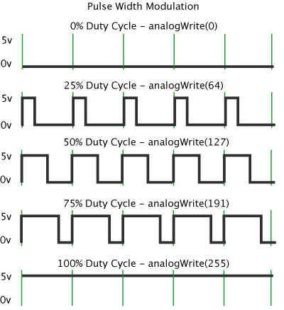
Stopped.
1/4 speed.
1/2 speed.
3/4 speed
full speed.

Slide 9
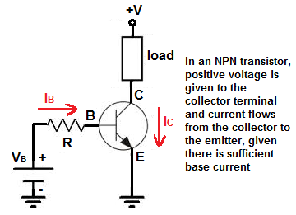
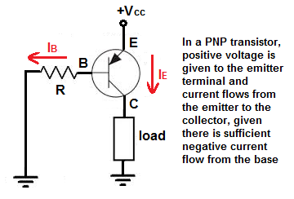
Transistors

Slide 10
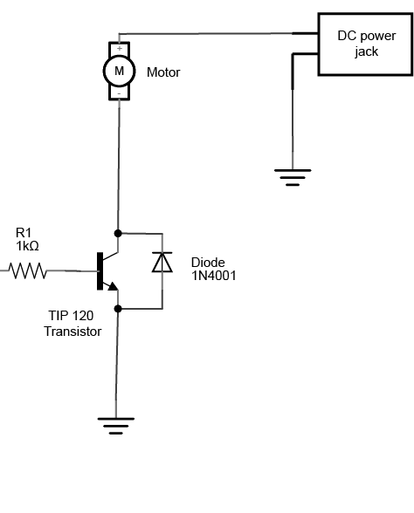
Why do we use transistors?
Sometimes motors need to use a higher voltage than our Arduino can provide. In these situations we use a second power supply and use a transistor to turn it on and off as needed.
We supply commonly use an NPN transistor and connect our 5V pin to the base. When our pin becomes HIGH the transistor will activate and our input voltage will flow.
Arduino

Slide 11
Reverse?
That’s all good, but how do we make it go in reverse?
As you know (and can demonstrate). You can reverse the turning direction by reversing the voltage. That’s easy to do by hand, but if we try doing that with our Arduino pins, it gets a little hard.
We can use transistors and diodes to make a circuit that lets us do all this. It’s called a H-bridge, and is fairly well known.

Slide 12
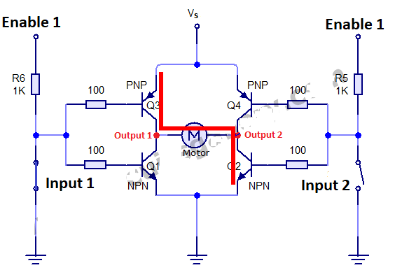
When input 1 is closed and input 2 is opened transistor Q3 and Q2 are opened/operational, allowing current to flow from them. The motor connected across the output 1 and 2 now starts rotating. The motor direction of rotation is clock wise. One PNP and one NPN transistor is activated when one input is closed and other is opened.

Slide 13
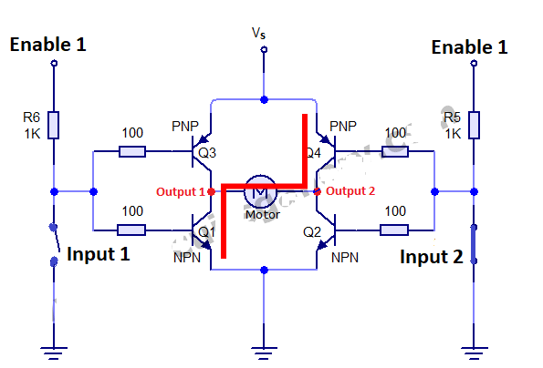
When input 1 is opened and input 2 is closed transistor Q4 and Q1 are operational. Current start flowing through this path and the motor starts moving in the anti clock wise direction. Enable is still at high potential and vs is supplied battery required voltage.
If both the input 1 and input 2 are opened or closed to current path will be established and motor will not rotate. If any input is closed and enable is not at high potential than still the circuit will not work. Enable is a master pin and controls the whole circuit.

Slide 14
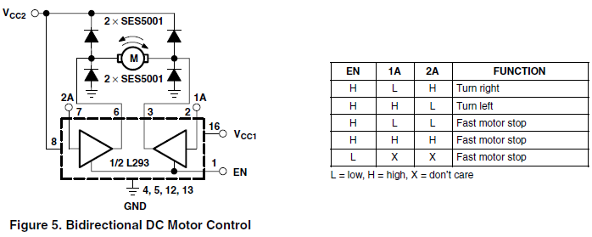
H-Bridge controlling a motor

Slide 15
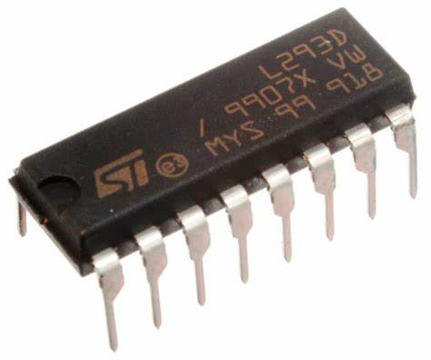
This is a little messy and hard work.

Slide 16
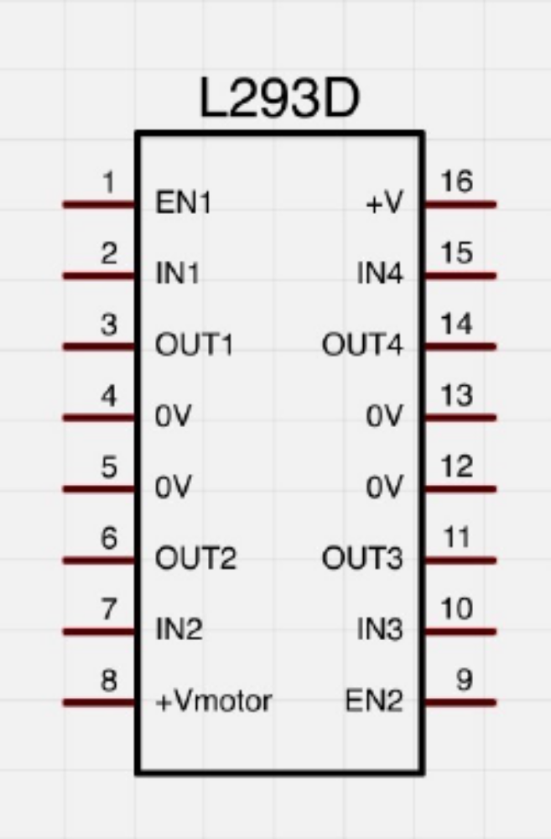
L293D H Bridge
Each side of this chip has a H bridge to control a DC motor. So on our robot car we can use 1 chip to control 2 wheels.
Pin 16 is the V+ for the chip (5V).
Pin 8 is the V+ for the motor (we use 5V but it can be between 0V to 36V).

Slide 17
2 summary
LEARNING RESOURCES AVAILABLE
LEARNING ACTIVITIES
  Learning to control speed and direction of motors using H Bridge.
  Show operation of motors
  Build sensor circuit for the 2 light detectors
TASKS TO BE COMPLETED
  Set up motor to operate using adafruit-arduino-lesson-15-dc-motor-reversing lab sheet
  Demonstrate adjusting speed of motor
  Run motors in forward and reverse

Slide 18
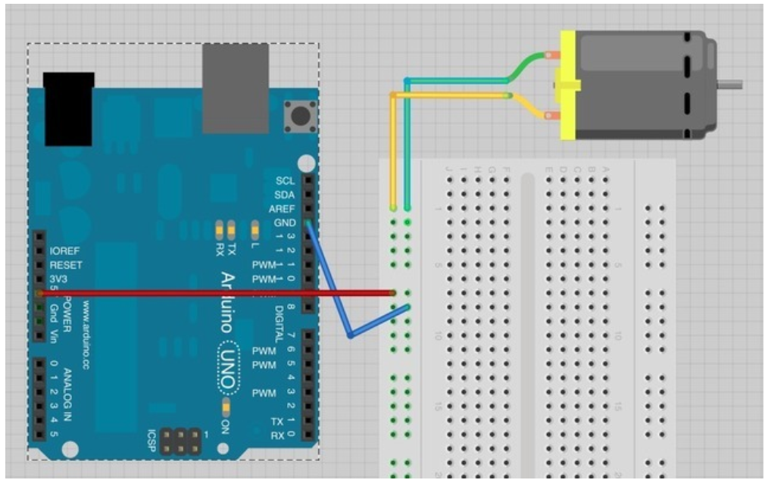
Running a dc motor directly from a power supply

Slide 19
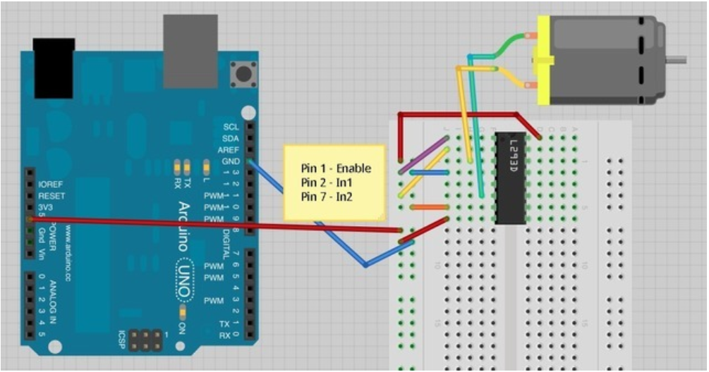
Running a DC motor from an H-Bridge but not controlling speed

Slide 20
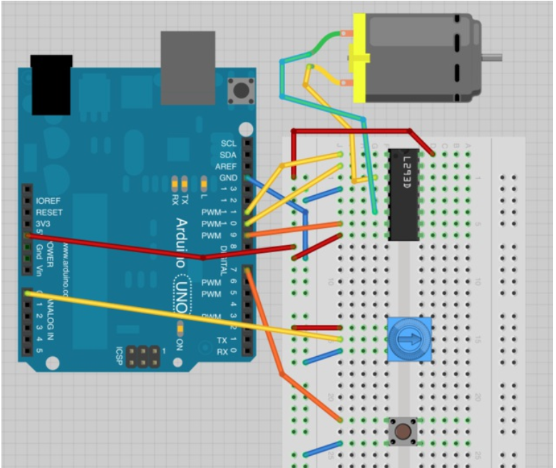
Running a dc motor controlling speed and direction

Slide 21
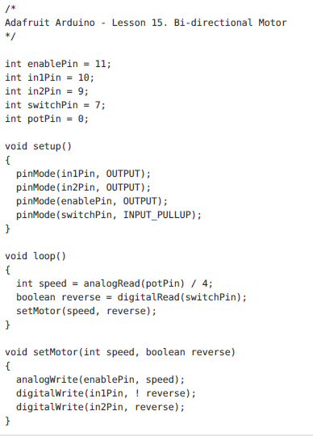
Code

Slide 22
TASKS TO BE COMPLETED
  Set up motor to operate using adafruit-arduino-lesson-15-dc-motor-reversing lab sheet
  Demonstrate adjusting speed of motor
  Run motors in forward and reverse
  Build sensor circuit for the 2 light detectors

